Slide 1






Creating PowerShell Cmdlets
PowerShell Conference Asia
- Rakesh K. Kethineedi

Slide 2


About Me
Automation advocate
Passionate about PowerShell
Works at Robert Bosch, Singapore
Co-organizer of Singapore Veeam User Group
Twitter: @rakeshkarthikk
Blog: http://rakeshkethineedi.blogspot.sg/
PowerShell Conference
Singapore 2017

Slide 3
Understanding the audience’s expectation
How many of you have created PowerShell cmdlets before?
How many of you have created PowerShell functions before?
PowerShell Conference
Singapore 2017

Slide 4
What to expect?
Understand different ways of creating Cmdlets
Able to kickstart your PowerShell Cmdlet development
PowerShell Conference
Singapore 2017

Slide 5
Cmdlet functionality
Get-ChildItem –path "C:\apps" | Measure-Object
Parameters
Ability to accept pipeline input and send output to the pipeline
Verb-Noun
PowerShell Conference
Singapore 2017

Slide 6
Cmdlets creation ways
PowerShell scripting
C#.NET
PowerShell Conference
Singapore 2017
Notes:
Adv of using C# - Tricks like LINQ, Lambda Expressions are available in C#.
Reuse existing code – encapsulate business logic etc.

Slide 7
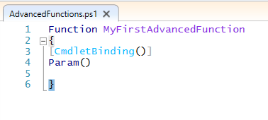
Using PowerShell – PS Advanced Functions
PowerShell Conference
Singapore 2017

Slide 8
Main functionalities
Advanced Parameters
Pipeline Input Acceptance
PowerShell Conference
Singapore 2017

Slide 9
Control the Parameters
Mandatory
Validation
PowerShell Conference
Singapore 2017

Slide 10
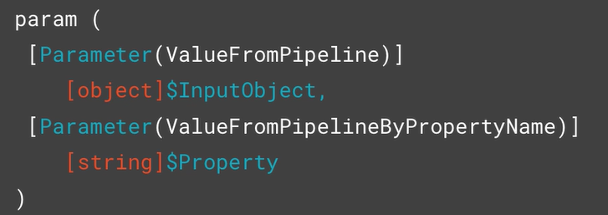
Accepting Pipeline Input
By Object
By Property
PowerShell Conference
Singapore 2017

Slide 11
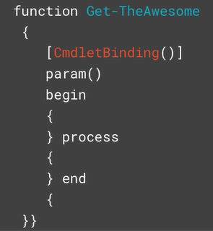
Begin, Process and End blocks
Begin – Executes only once
- Declaration, initialization of vars
Process: Executes for every object from the pipeline
End: Executes for the last object of the pipeline
- Remove ps remoting session, temp files etc.
PowerShell Conference
Singapore 2017

Slide 12
Building Cmdlets using C#
Prerequisites:
Visual Studio and Windows SDK
Powershell 3+
Basics of C#.NET programming and PowerShell
PowerShell Conference
Singapore 2017

Slide 13
Environment Readiness
Create a C# “Class Library” Project in Visual Studio
Add Reference to System.Management.Automation
PowerShell Conference
Singapore 2017

Slide 14
Two paths
Inheriting from one of two classes
Cmdlet
Simple
Smaller footprint
Less Access
80% of the cmdlets are of this type
PSCmdlet
Slightly more complex
Larger system resources
Full PS environment
PowerShell Conference
Singapore 2017

Slide 15
DEMO – Manually Testing the Cmdlets
PowerShell Conference
Singapore 2017

Slide 16
Minimum requirement
Inherit from Cmdlet Class
Decorate the class in Verb Noun format
PowerShell Conference
Singapore 2017

Slide 17
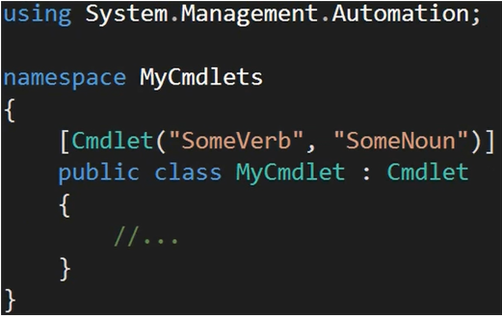
Basic Cmdlet
PowerShell Conference
Singapore 2017

Slide 18
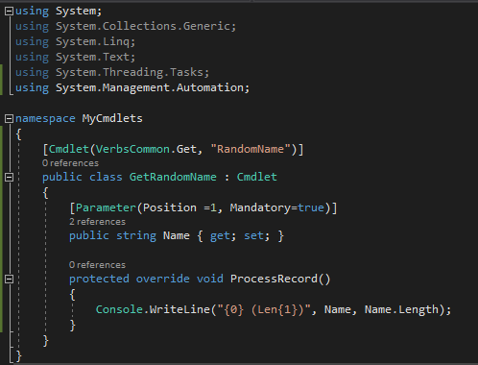
Parameters
PowerShell Conference
Singapore 2017

Slide 19
Overridable Methods
ProcessRecord – Processes the info for all elements of the object
BeginProcessing – Initializing resources. Called only once.
EndProcessing – Properly dispose resources. Called only once.
StopProcessing – Abrupt stop of execution. Eg: Ctrl+C.
PowerShell Conference
Singapore 2017

Slide 20
Cmdlet Output
Not Console.WriteLine
Write.Object() - Mostly used
PowerShell Conference
Singapore 2017

Slide 21
Others
WriteVerbose
WriteDebug
WriteWarning
WriteError
PowerShell Conference
Singapore 2017

Slide 22
QUESTIONS?
PowerShell Conference
Singapore 2017

Slide 23
Don’t Forget!
Fill in your survey in Mobile app – it’s how we do better!
Don’t lose you badge! You need it for the Social Events
Grab the Speakers for a chat – they all have time for you!
Let everyone know what they are missing on Social Media
#PowerShell
#PSConfAsia
Photos of Marina Bay Credit: Sebastian Szumigalski
PowerShell Conference
Singapore 2017

